Slide 1



Differential preference in the choice of nominal classification rules in Kîîtharaka
Patrick Kanampiu¹, Alexander Martin², Jennifer Culbertson¹
WOCAL 11
August 6th, 2024
¹University of Edinburgh
²University of Groningen

Slide 2
Grammatical gender systems
Systems that group nouns based on nominal agreement (see e.g., Hockett 1958, Corbett 1991, Guldemann & Fiedler 2019)
French
Kîîtharaka
1. | le | ballon
 | the.M | Ball.M
3. | mu-ntû | û-mwe
 | 1-person | 1-one
2. | la | Camionnette
 | the.F | van.F
4. | ka-bûri | ka-mwe
 | 12-kid | 12-one

Slide 3
Grammatical gender system are complex
Gender agreement mainly depends on meaning and formal cues of the noun:
  The different cues (prefixes or suffixes, semantic or formal) differ in reliability (see e.g., Karmiloff, 1981; Gagliardi & Lidz , 2014)
  Sometimes there is no overlap between cues (semantic and formal) and agreement ( i.e., exceptions)
  There are novel/loan nouns without formal features
meaning form
3. | mu-ntû | û-mwe
 | 1-person | 1-one
4. | î-the | û-mwe
 | 5-father | 1-one
5. | Kî-roria | kî-mwe
 | 7-prophet | 7-one
6. | thaa | î-mwe
 | watch | 9-one

Slide 4
State of the art
Previous studies have sought to establish:
  Which rules are productive for gender assignment in specific languages (see e.g., Enger 2009, Morin 2010, Mastropavlou & Tsimpli 2011, Del Tomba 2023, Kanampiu et al. 2024 )
  How nouns that do not conform to gender assignment cues are treated (see e.g., Rabeno & Repetti 1997, Demuth 2000, Van de Velde 2006, Melissaropoulou 2016, Mar ́ıa del R ́ıo-Gonza ́lez 2021)

Slide 5
State of the art
Interaction between gender assignment cues of different types (see e.g., Karmiloff 1981, Kilarski 2003, Nesset 2006, Enger 2009, Thornton 2009, Gagliardi & Lidz 2014 )
Some of these (influential) experimental studies have established:
  Developmental difference: children acquiring noun classes, unlike adults prefer to use formal cues (e.g., phonology) even when more statistically reliable semantic cues are available ( e.g., Karmiloff 1981)
  Adults more likely to use semantics (Culbertson et al. 2017, 2019)
    But are sensitive to highly salient formal cues as well ( e.g., Frigo & McDonald 1998, Culbertson et al. 2017)

Slide 6
The aim of the current study
Focus on gender assignment Kîîtharaka (Bantu, E54)
  Relatively little prior research using psycholinguistic methods to evaluate cues that learners/speakers find productive
  Gender in Bantu languages differ (mainly) from I.E counterparts in important ways
    Many genders/classes genders involved (2–22)
    Ubiquitous nominal prefixes and rich prefixal agreement morphology

Slide 7
Do speakers and learners of these languages show consistent preference for given cue types?
Sesotho (Demuth 2000; corpus-based study):
Children acquiring noun classes mainly rely on nominal prefixes
Evidence in adults come only from loan words
Open question: Do adults use form more productively than meaning?

Slide 8
Do speakers and learners of these languages show consistent preference for given cue types?
Kinyarwanda (Jerro et al., Under review); experimental study):
Tested whether speakers categorize nouns based on morphology or meaning
  Based on a triad task; participants given sets 3 nouns sharing meaning, morphology or neither, and asked to select the most different
  Participants were more likely to group nouns based on meaning but were more likely to use morphology if they spoke Swahili.
Did not directly address productive use of cues in classifying novel nouns

Slide 9
Do speakers and learners of these languages show consistent preference for particular cue types?
Kîîtharaka (Kanampiu et al., in print); experimental study):
Investigated whether adult speakers of Kîîtharaka productively use semantic and morphophonological cues in novel nouns to determine gender agreement
  All formal features tested were productive
  Only a subset of semantic features (e.g., Human, fruit, narrow, evaluative meaning) were productive
Did not investigate whether speakers rely on meaning or form when they conflict – i.e., which takes priority?

Slide 10
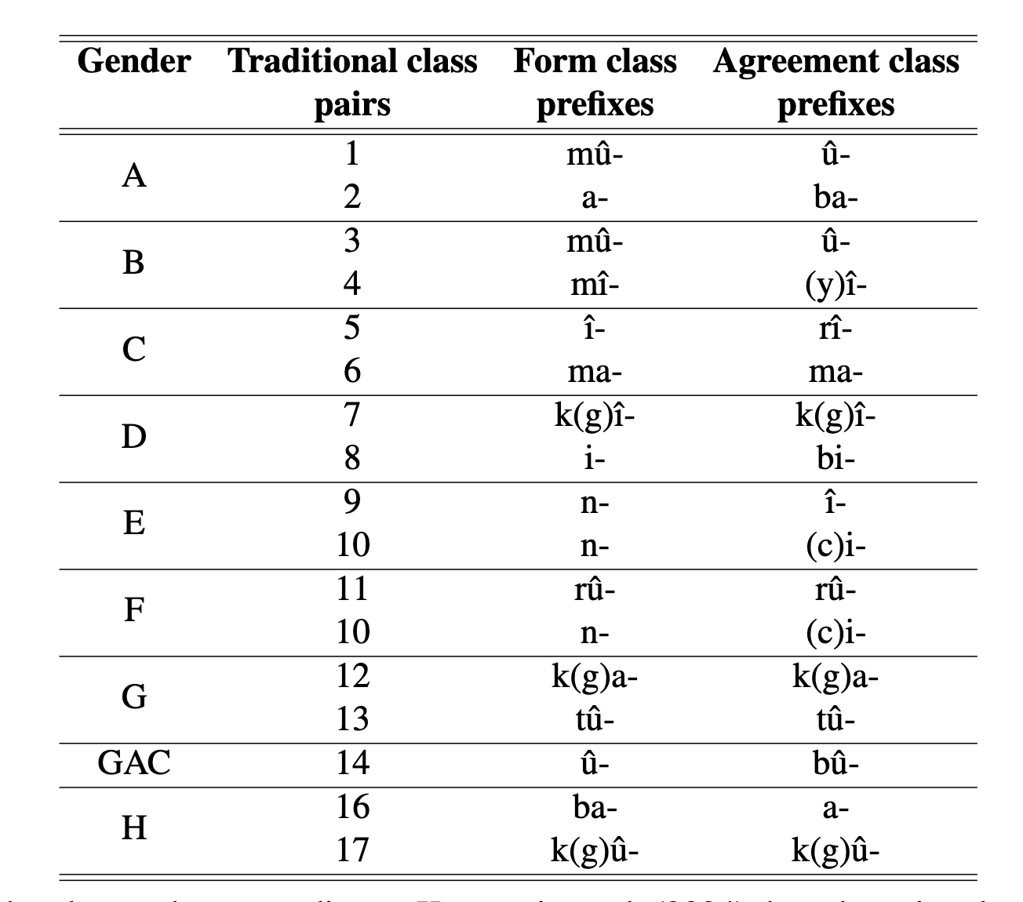
The Kîîtharaka gender system
Typical of Bantu gender system, different
from Indo-European systems:
  Many classes: 8 genders
  (sing/plural pairs)
  Ubiquitous nominal prefixes
  Rich agreement morphology
  Semantic heterogeneighty
  (see,e.g., wa Mberia, 1993)

Slide 11
An experimental investigation of conflicting cues in Kîîıtharaka
Current study investigated what cue types speakers of Kîîtharaka rely on when both conflict
Previous studies (non-Bantu) found that participants may prefer certain cue types based on:
  Cue (statistical) reliability, relative salience (Gargliardi & Lidz, 2014, Culbertson et al. 2017)
  Cognitive biases e.g., tendency to form categories based on core knowledge (Strickland 2017, Meir et al. 2017)
    Even in infancy, learners are primed to classify entities in certain ways (e.g., mass/kind-; animate/inanimate distinctions)

Slide 12
Methods
  Materials
  The experiment included visual and linguistic stimuli (orthographically presented)
  Participants saw an image depicting a target semantic feature followed by a descriptive phrase in a carrier sentence e.g.,
  a Kîîtharaka speaker saw ‘mûkithe __mwe.’
Semantic feature | morphophonological feature
 | Aligned | Conflicting
Human | mû- | rû-, û-
Augmentative | î- | mû-, n-, rû-, û-
Pejorative | gî-
Diminutive | ga-
Aligned: prefix cues same class as meaning
Conflicting: prefix cues different class from meaning

Slide 13
Methods
Procedure:
Administered via Qualtrics
Four blocks: Human, Augmentative, Pejorative, Diminutive
Image appeared along with critical prefix+stem
Participants were asked to provide missing agreement on numeral ‘one’
Participants:
44 native speakers of Kîîtharaka (students of Tharaka University, Kenya)

Slide 14
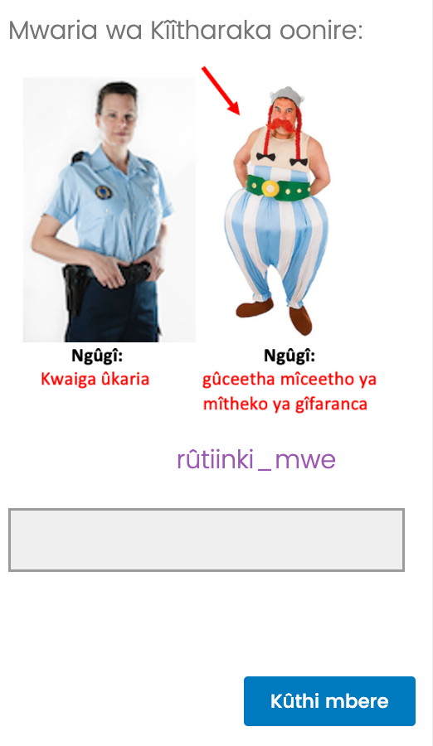
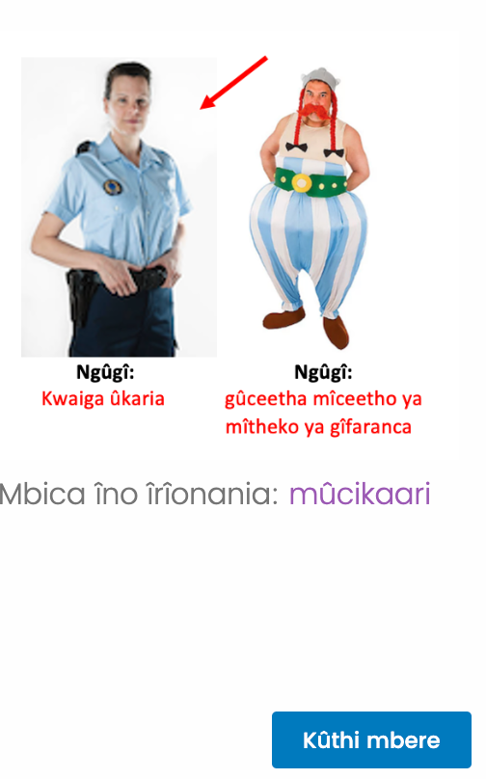
Sample trial: Human block
    rûtinki _one
“A Kîîtharaka speaker saw: rûtinki _one”
rûtinki _mwe
“This picture shows: [mû-]“police”

Slide 15

Sample trial: Evaluative blocks
“A Kîîtharaka speaker saw: mûkero _one”
mukero
mukero _mwe
“This picture shows: mû-kero”
(a) Augmentative

Slide 16
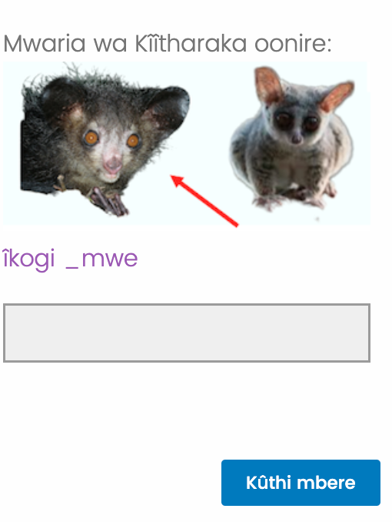
Sample trial: Evaluative blocks
“A Kîîtharaka speaker saw: îcogi _one”
îcogi
îcogi _mwe
“This picture shows: î-cogi”
(b) Pejorative

Slide 17
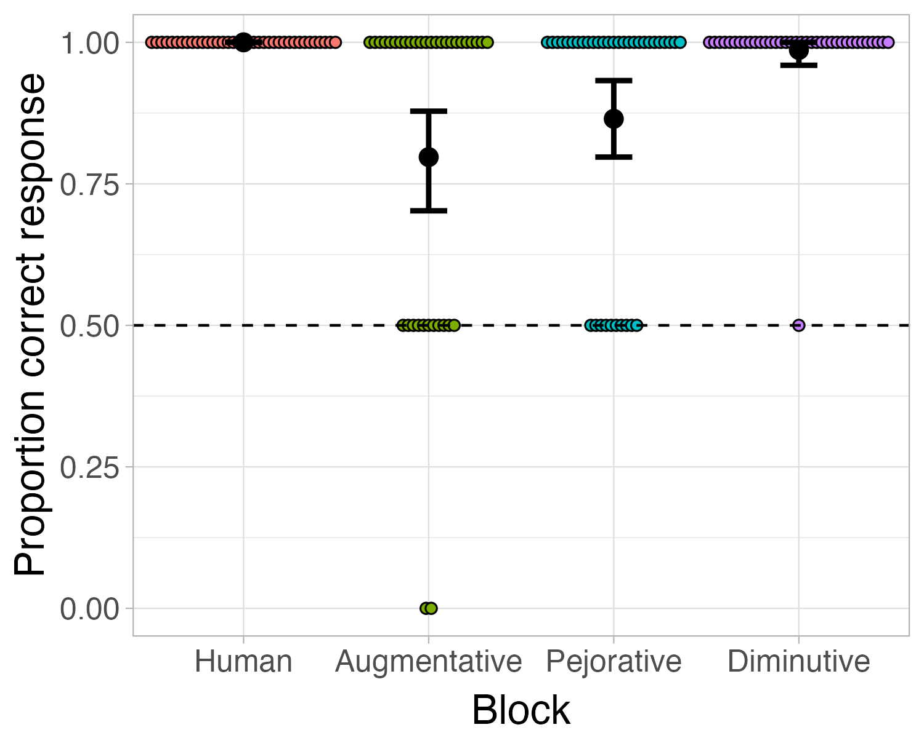
Results: Aligned trials
Correct responses in Aligned trials by block

Slide 18
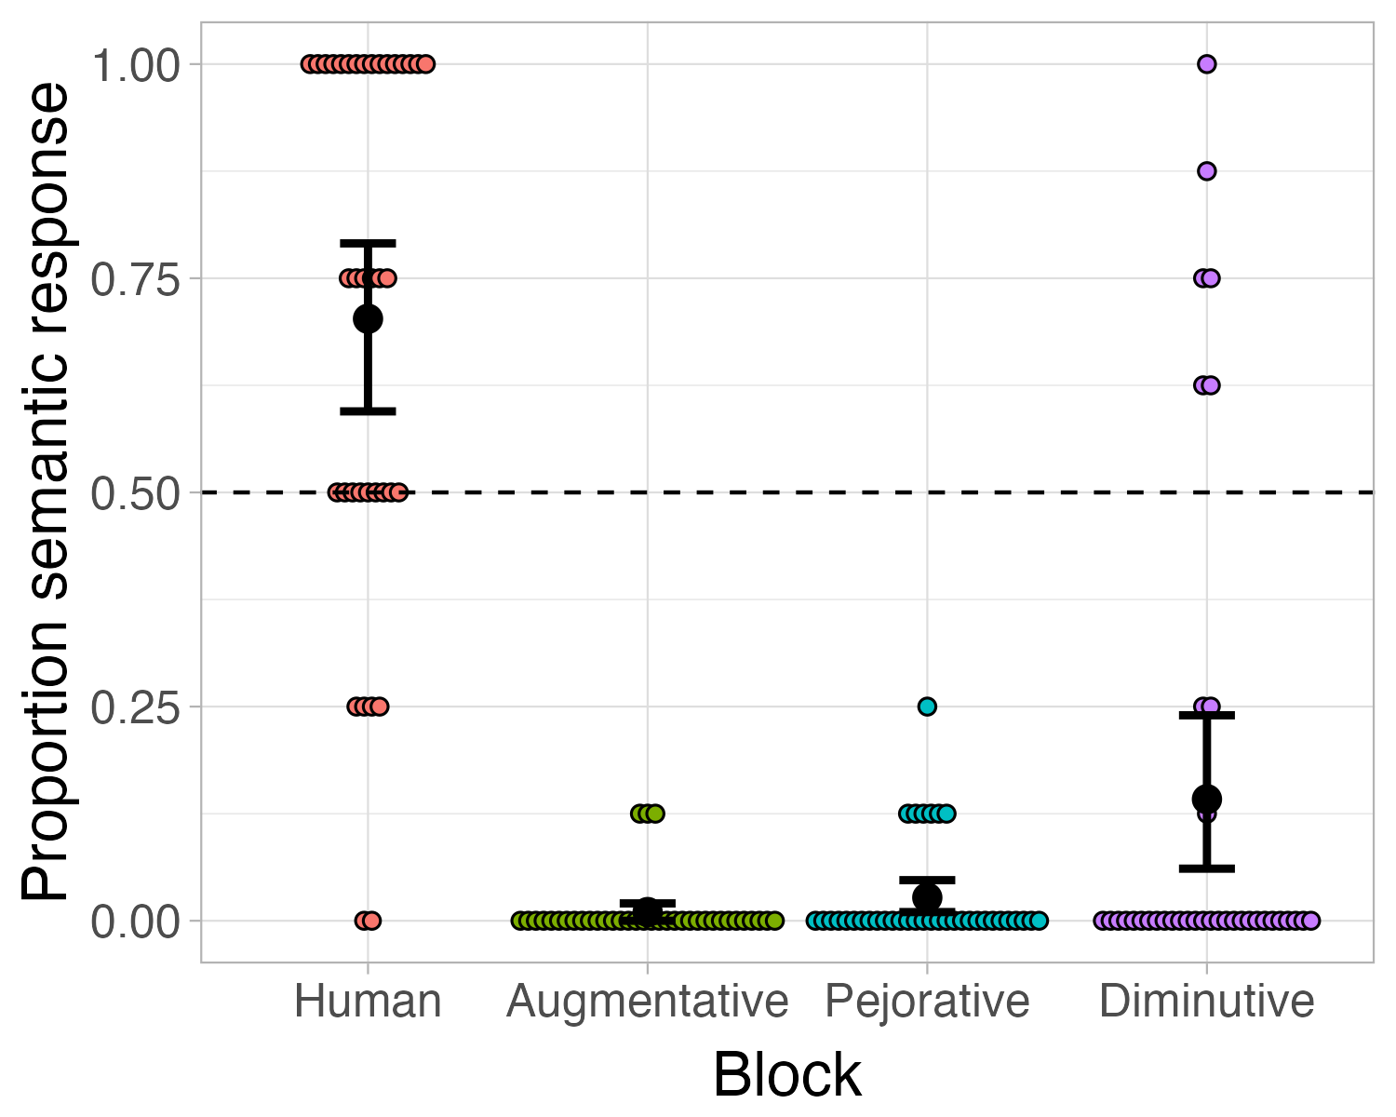
Results: Conflicting trials
Semantic assignment by block
Statistical analyses (LMER)):
Human block significantly
Different from other meanings

Slide 19
Discussion
Why is human feature more reliable that other semantic features?
  Statistical reliability?
  Conceptual accessibility or perceptual salience?
Why do adult speakers of Kîîtharaka differ from those in other studies in their overwhelming preference for morphophonology?
  Prominence and reliability of morphophonology as a cue type- nominal prefixes are ubiquitous and highly productive

Slide 20
Future work
Run tests with child participants to establish whether this differential preference (and strong role of human-ness) is present at the age of acquisition or develops over time
Reproduce the study with adult participants of other systems with highly reliable morphophonological cues e.g., Spanish

Slide 21
Thank you for listening!
Questions, and comments/suggestions are welcome!

Slide 22
References
Corbett, Greville G et al. 1991. Gender. Cambridge University Press.
Culbertson, Jennifer, Annie Gagliardi & Kenny Smith. 2017. Competition between phonological and semantic cues in noun class learning. Journal of Memory and Language 92. 343–358.
Culbertson, Jennifer, Hanna Jarvinen, Frances Haggarty & Kenny Smith. 2019. Children’s sensitivity to phonological and semantic cues during noun class learning: Evidence for a phonological bias. Language 95(2). 268–293.
D ́echaine, Rose-Marie, Rapha ̈el Girard, Calisto Mudzingwa & Martina Wiltschko. 2014. The internal syntax of shona class prefixes. Language sciences 43. 18–46.
Del Tomba, Alessandro. 2023. The gender system of tocharian: A synchronic and typological overview. In The tocharian gender system, 9–65. Brill.
Demuth, Katherine. 2000. Bantu noun class systems: Loan word and acquisition evidence of semantic productivity. Systems of nominal classification 270–292.
Enger, Hans-Olav. 2009. The role of core and non-core semantic rules in gender assignment.Lingua 119(9). 1281–1299.
Frigo, Lenore & Janet L McDonald. 1998. Properties of phonological markers that affect the acquisition of gender-like subclasses.Journal of Memory and Language 39(2). 218–245.
Gagliardi, Annie, Naomi H Feldman & Jeffrey Lidz. 2017. Modeling statistical insensitivity:Sources of suboptimal behavior. Cognitive science 41(1). 188–217.
Kanampiu, Patrick, Alexander Martin & Jennifer Culbertson. Under review. Experimental evidence for semantic and morphophonological productivity in kˆıˆıtharaka noun classes .

Slide 23
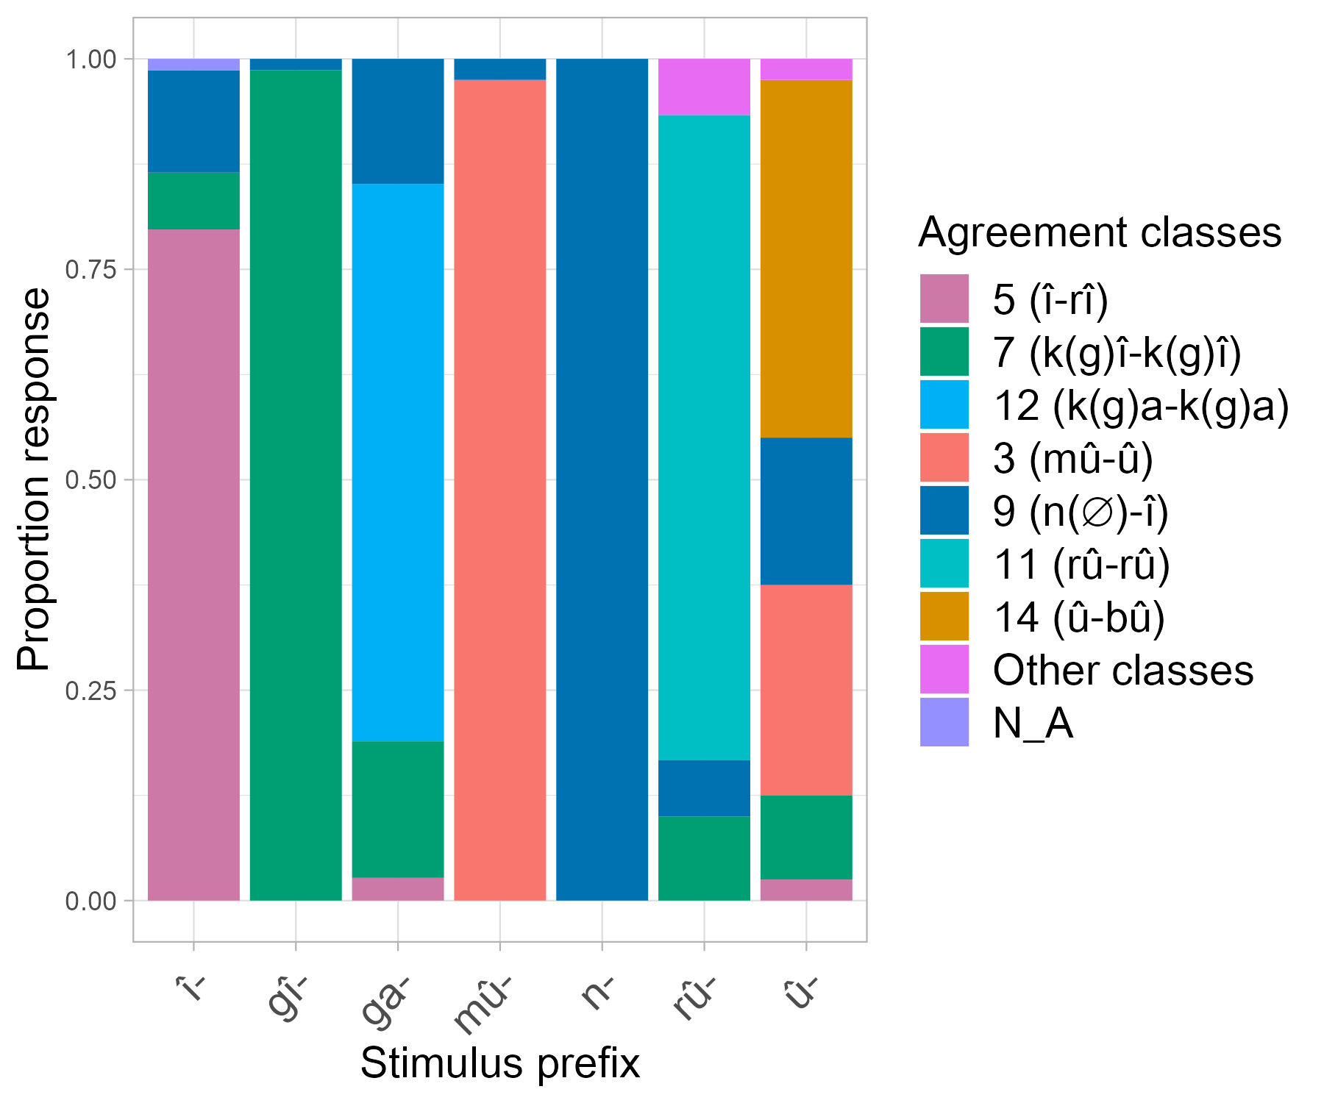
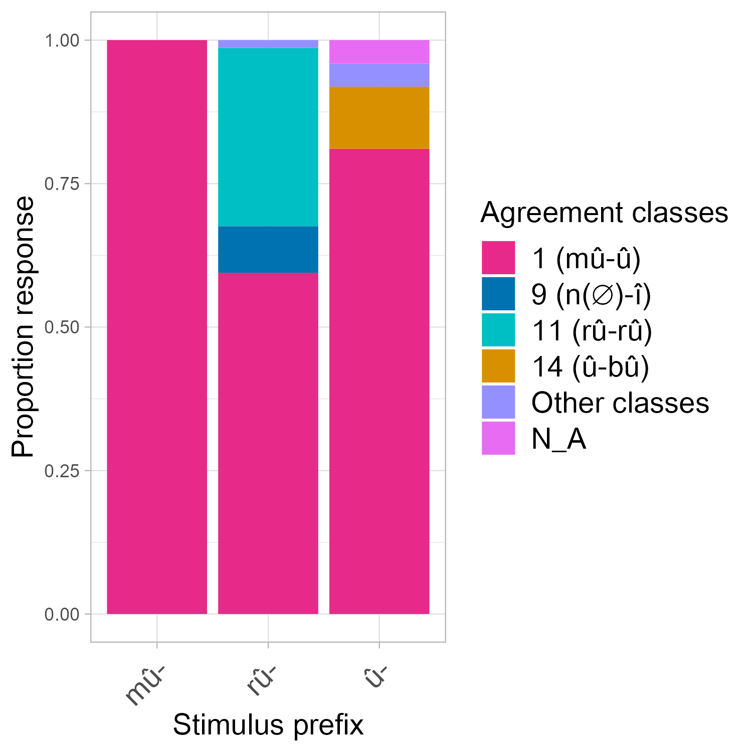
Results
Human block
Augmentative block

Slide 24
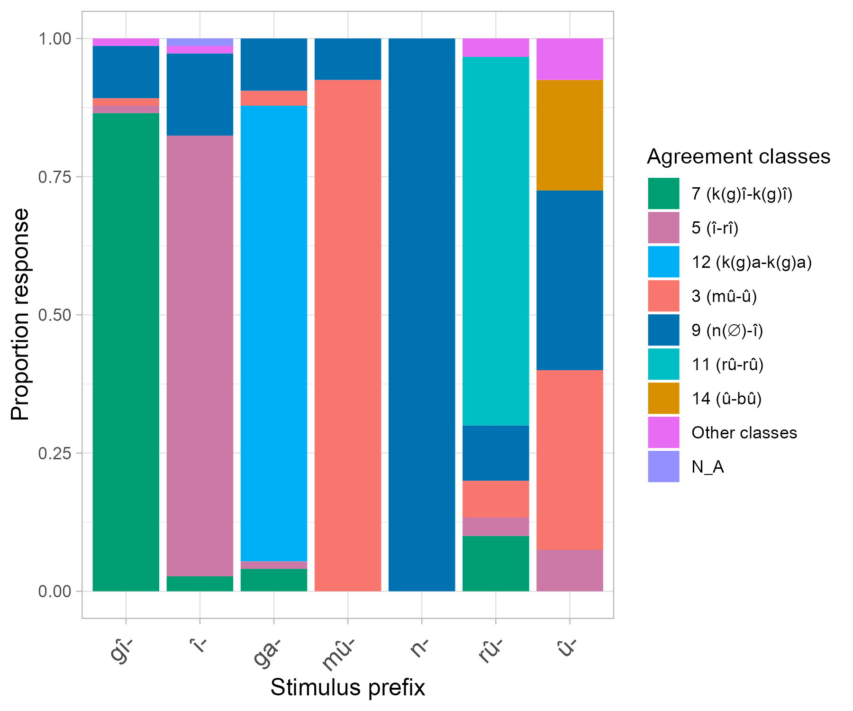
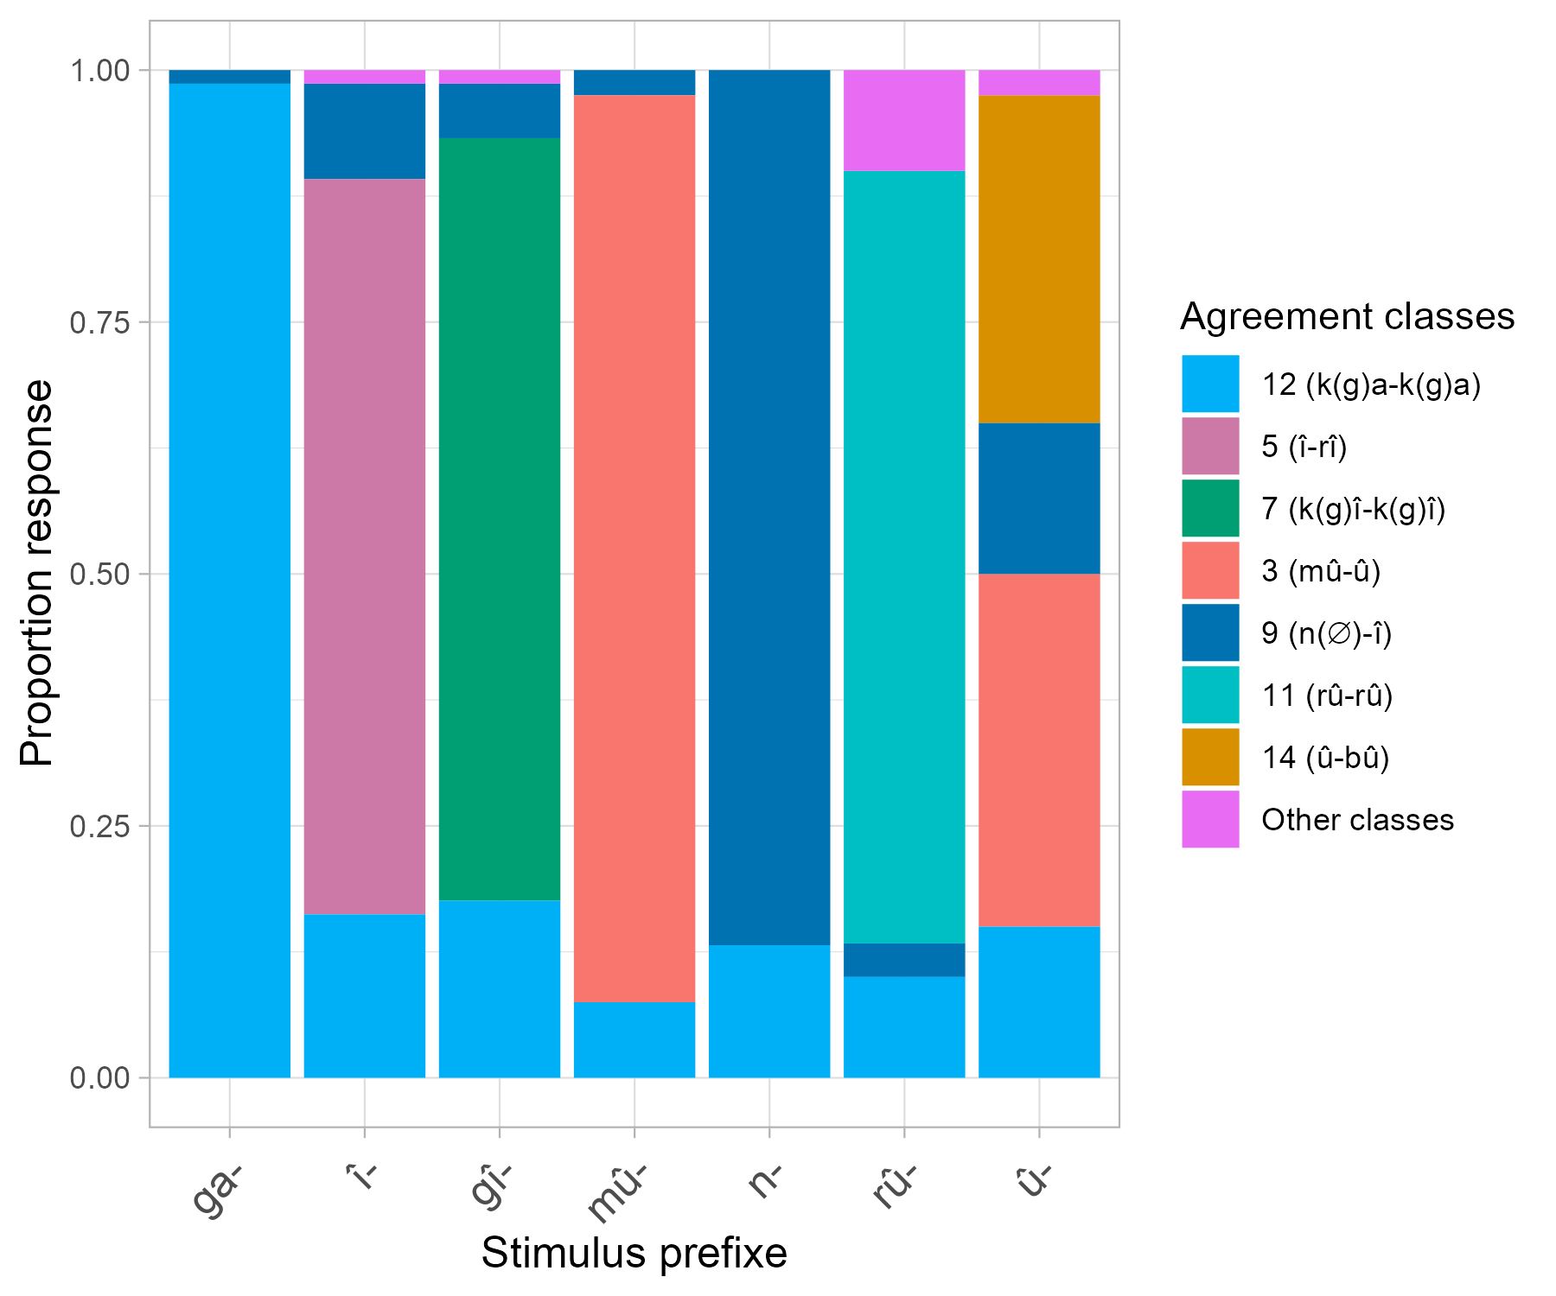
Results
Pejorative block
Diminutive block

Slide 25
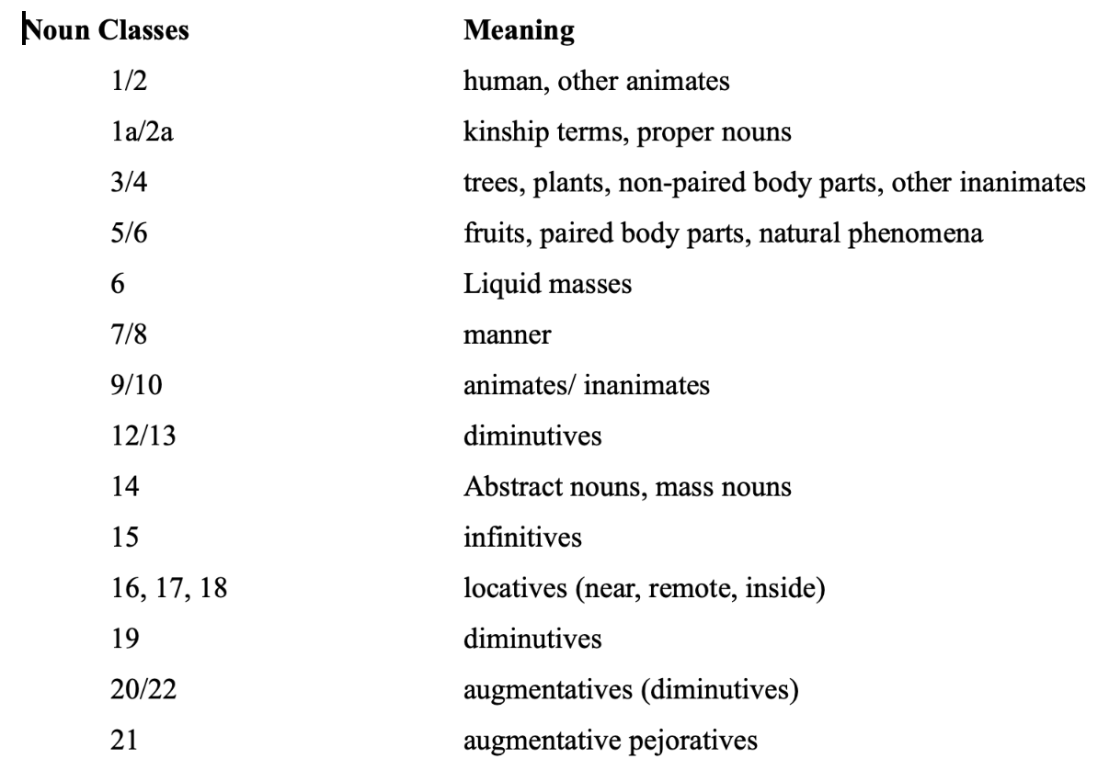
Traditional approaches to Bantu noun classes
  There are complexities...
  Semantic heterogeneity/shared meaning across classes
other animates
other inanimates
animates
inanimates
diminutives
(Proto Bantu,
Richardson, 1967;
Welmers, 1973)
diminutives
diminutives)

Slide 26
Semantic features coded for
Expected Class | Semantic Feature(s)
1 | human
3 | Extended shape, spread shape, protruding shape, trees & plants, dispersive mass
5 | Fruits, round shape, plant part, augmentative, made of wood, cohesive mass
7 | Artefacts, pejorative, derived
9 | Animals, artefacts, loan (other)
11 | Narrow things, wavy-shaped things
12 | Diminutives
14 | Abstract, mass
15 | Derived, infinitives

